Slide 1

MT8811- PROJECT FINAL REVIEW 22.05.2023 DEPARTMENT OF MECHATRONICS AGNI COLLEGE OF TECHNOLOGY

Slide 2
Design and Fabrication of a Smart Nursing Robot
BATCH DETAILS
BATCH NUMBER - 10
DEVANAND K - 312819115008
JONATHAN J - 312819115014
ARAVA JOHN SATHYA - 312819115301
SUPERVISOR NAME: Mr. A. BACKIYARAJ
DESIGNATION: ASSISTANT PROFESSOR, MHT DEPARTMENT

Slide 3
INTRODUCTION
The current global economic situation with respect to working population in the Nursing and Care taking sector is dipping in involvement ratio. Whereas in other hand human population in total is increasing manifold. Demand for workers in the nursing sector and very low supply has given rise to technological advancement and possibilities for building Nursing Robots.

Slide 4
LITERATURE REVIEW
S.NO | AUTHOR NAME | YEAR OF PUBLICATION | JOURNAL NAME | INFERENCE
1. | Amal Abutaleb, Jory Alsabhani, Sadeem Alkinani, Shahad Alkaydi, Sara Alghamdi, Ahmed Bensenouci | 2020 | IEOM Society International | Basic Design and components used.
2. | Tetsuya Tanioka, Kyoko Osaka, Rozzano Locsin, Yuko Yasuhara, Hirokazu Ito | 2017 | Scientific Research Publishing | Development of Nursing Robot along with it’s impact on Human interaction.

Slide 5
S.NO | AUTHOR NAME | YEAR OF PUBLICATION | JOURNAL NAME | INFERENCE
3. | Celia Nieto Agraz 1 *, Max Pfingsthorn1 , Pascal Gliesche1 , Marco Eichelberg1 and Andreas Hein2 | 2022 | Frontiers | Classification and Understanding of nursing and care giving robot.
4. | Eftychios G. Christoforou1 , Sotiris Avgousti 2 , Nacim Ramdani 3 , Cyril Novales 3 and Andreas S. Panayides 4 * | 2020 | Frontiers | Potential of nursing and assistive robotics in improving the efficiency and quality of care while reducing costs in healthcare environments.

Slide 6
S.NO | AUTHOR NAME | YEAR OF PUBLICATION | JOURNAL NAME | INFERENCE
5. | Ricarda Servaty ,1,2 Annalena Kersten,3 Kirsten Brukamp,3 Ralph Möhler,4 Martin Mueller | 2020 | The BMJ | Foundation for high-quality randomized controlled trials, leading to informed discussions about the use of robotics in nursing among patients, healthcare practitioners, politicians, and the public.
6. | Servaty R, Kersten A, Brukamp K, Möhler R, Mueller M. | 2020 | The BMJ | Identified the barriers to and facilitators of the implementation of robotic devices in nursing within different dimensions.

Slide 7
PROBLEM STATEMENT
The potential in nursing robotic systems and care taking robotic systems have not been realized but is still in research stage. There is an increase in demand for nursing and care taking roles in the healthcare sector and shortage of human labour for the same. The scope of our project lies in solving the problem to fix this demand and supply chain through robotic technology.

Slide 8
OBJECTIVES
To design a nursing mobile nursing robot with basic medical diagnostic features and patient care provisions.
To fabricate and bring the design as a usable product in the real world application.
To assist a human nurse by interacting with patients and collecting and storing their vital details.

Slide 9
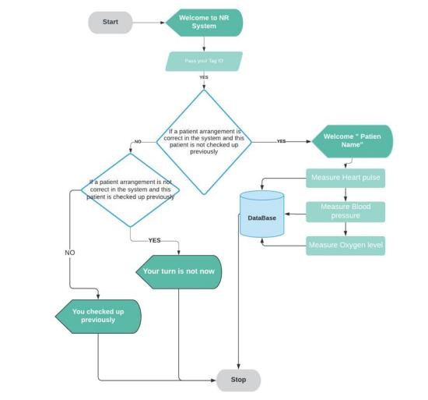
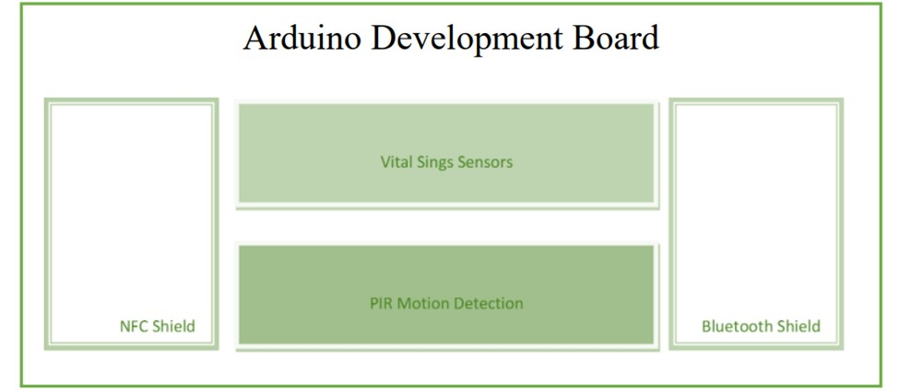
EXISTING SYSTEM

Slide 10
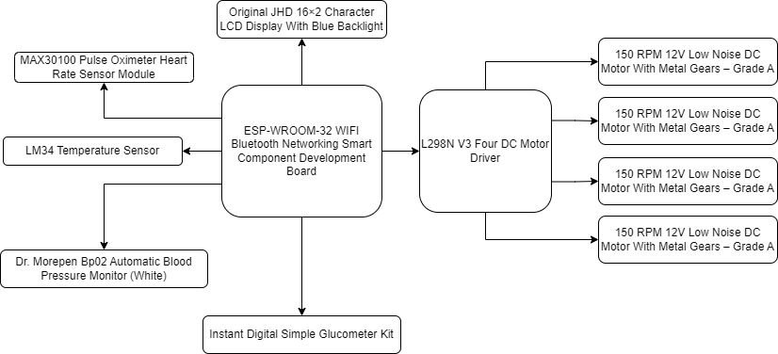
PROPOSED SYSTEM

Slide 11
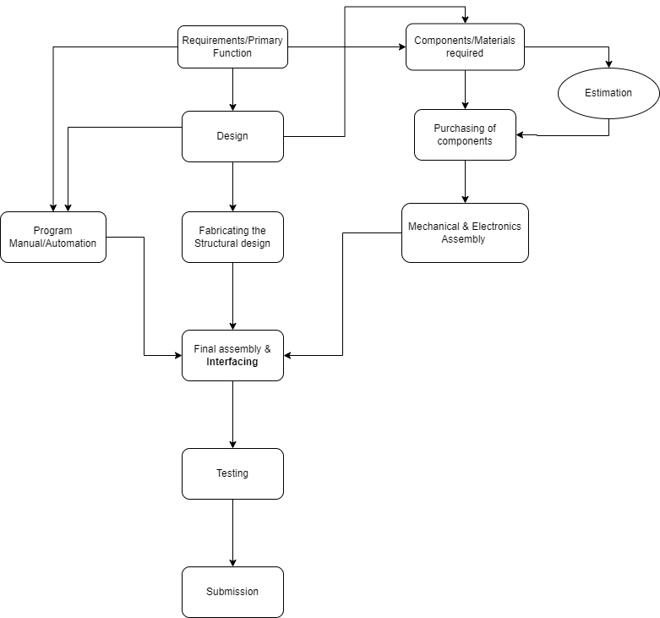
METHODOLOGIES TO MEET OBJECTIVES

Slide 12
HARDWARE SPECIFICATIONS
ESP-WROOM-32 WIFI Bluetooth Networking Smart Component Development Board
L298N V3 Four DC Motor Driver
150 RPM 12V Low Noise DC Motor With Metal Gears – Grade A
LM34 Temperature Sensor
MAX30100 Pulse Oximeter Heart Rate Sensor Module
Original JHD 16×2 Character LCD Display With Blue Backlight
Dr. Morepen Bp02 Automatic Blood Pressure Monitor (White)
Instant Digital Simple Glucometer Kit

Slide 13
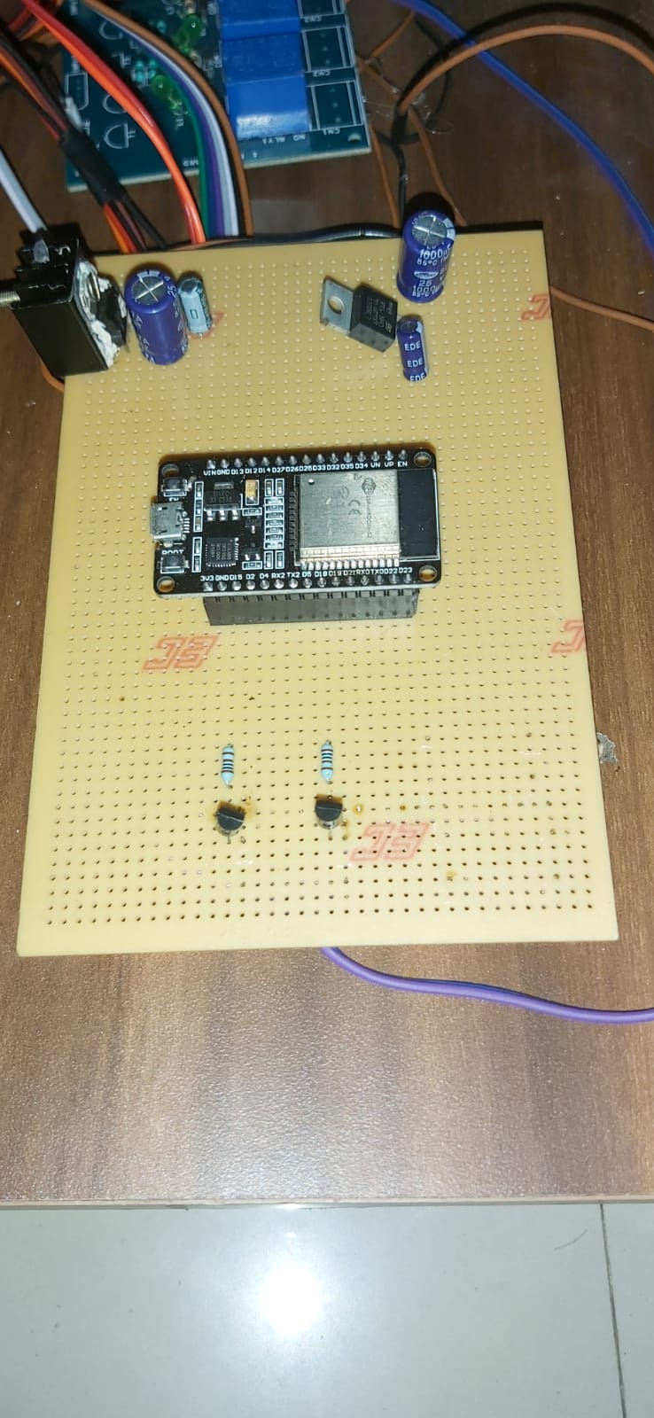
Specification of ESP-WROOM-32 WIFI Bluetooth Networking Smart Component Development Board
Processor | Two Low-Power Xtensa 32-bit LX6 Microprocessors
Operating voltage (v) | 3.0V – 3.6V
Operating current (mA) | 80
Clock Frequency (MHz) | 80 ~ 240
Flash memory (MB) | 4
Data Rate (Mbps) | 150
SRAM Memory (KB) | 520
Length (mm) | 28
Width (mm) | 50
Height (mm) | 14
Weight (gm) | 10
Shipment Weight | 0.015 kg
Shipment Dimensions | 6 × 8 × 2 cm

Slide 14
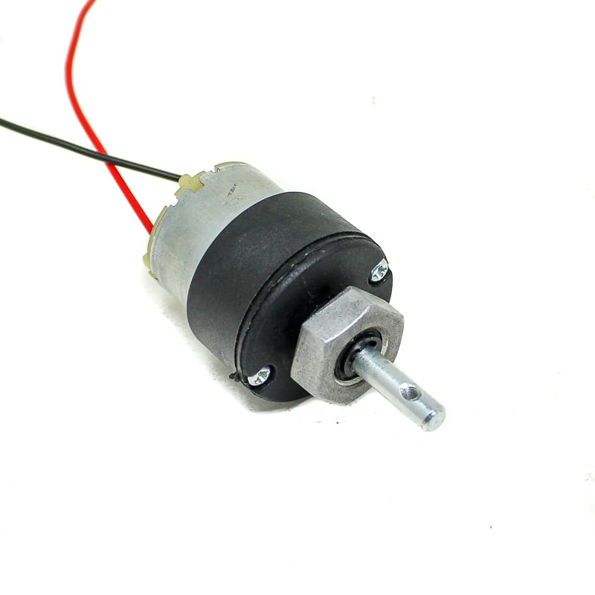
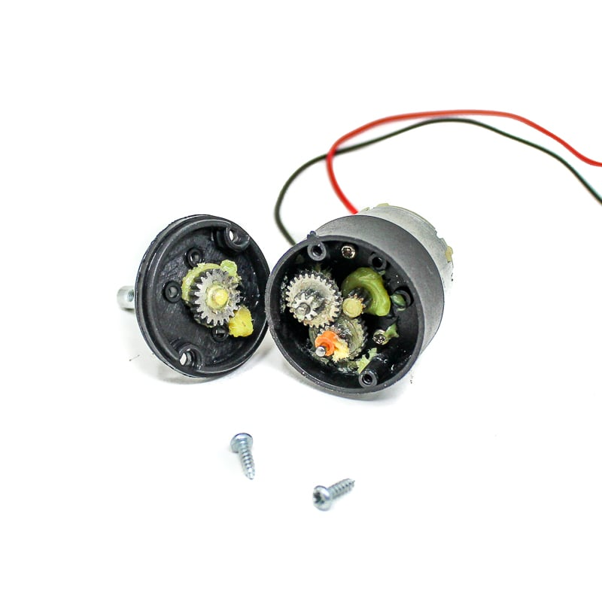
Specification of 150 RPM 12V Low Noise DC Motor With Metal Gears – Grade A
Gear Material | Metal
Rated Speed (RPM) | 150
Operating Voltage (VDC) | 12
Rated Torque(kg-cm) | 2
Gearbox Diameter (mm) | 38
Motor Diameter(mm) | 32
Motor Length (mm) | 75
Shaft Diameter (mm) | 6
Shaft Length (mm) | 21
Weight (gm) | 75
Shipment Weight | 0.1 kg
Shipment Dimensions | 9 × 5 × 5 cm

Slide 15
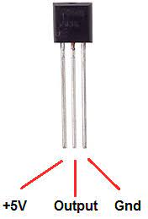
Specification of LM34 Temperature Sensor
Calibrated Directly in Degrees Fahrenheit
Linear 10.0 mV/°F Scale Factor
1.0°F Accuracy Assured (at 77°F)
Rated for Full −50° to 300°F Range
Suitable for Remote Applications
Low Cost Due to Wafer-Level Trimming
Operates From 5 to 30 Volts
Less Than 90-µA Current Drain
Low Self-Heating, 0.18°F in Still Air
Nonlinearity Only ±0.5°F Typical
Low-Impedance Output, 0.4 Ω for 1-mA Load

Slide 16
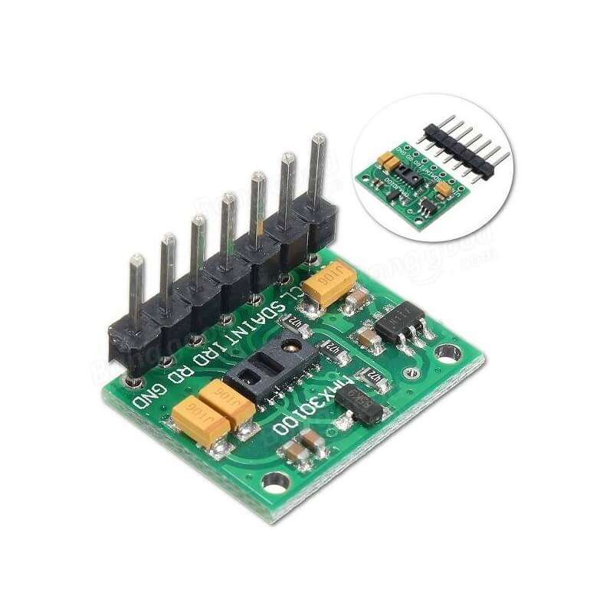
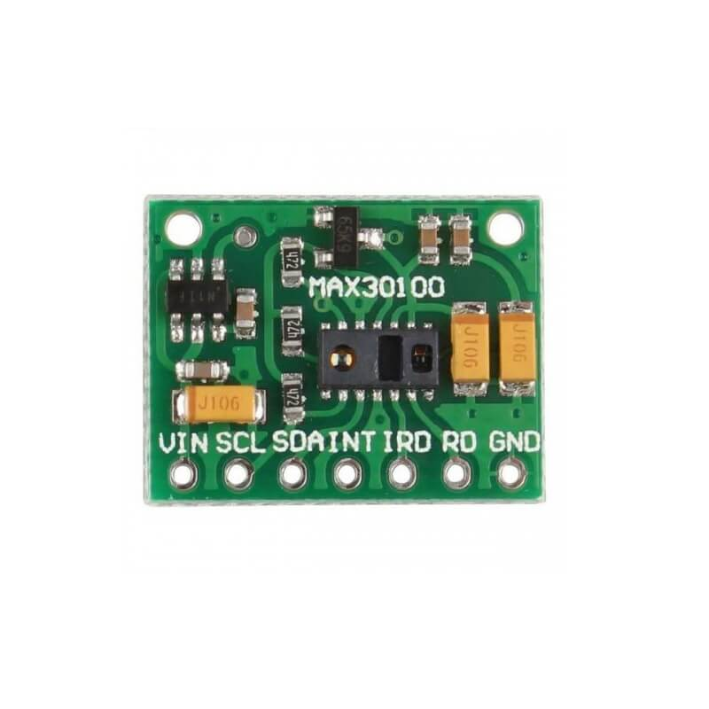
Specification of MAX30100 Pulse Oximeter Heart Rate Sensor Module
Working voltage | 1.8 ~ 5.5V
Shutdown Current | 0.7ÂµA
Color | Green
Length (mm) | 19
Width (mm) | 14.5
Height (mm) | 3
Weight (gm) | 2
Shipment Weight | 0.005 kg
Shipment Dimensions | 8 × 6 × 4 cm

Slide 17
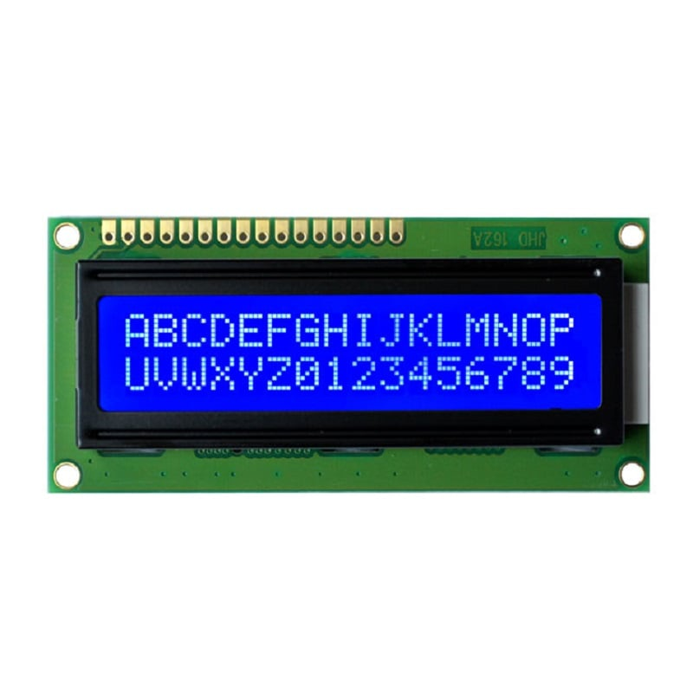
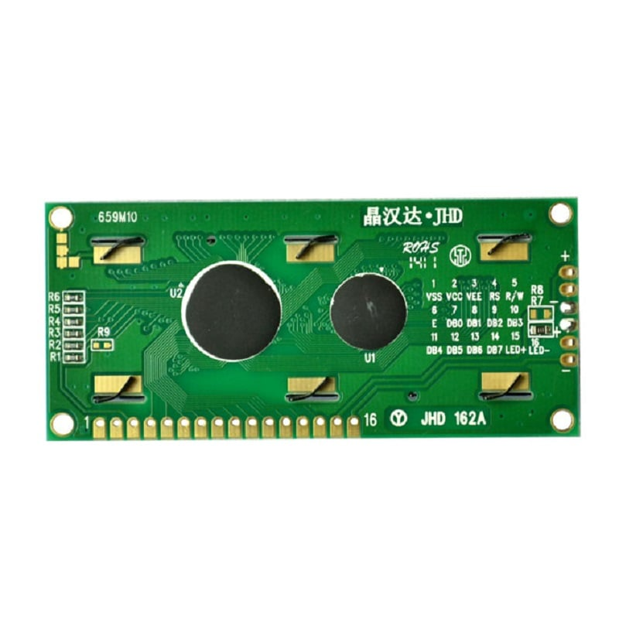
Specification of Original JHD 16×2 Character LCD Display With Blue Backlight
Model： JHD659 B/W
Display： 16×2 character
Outline： 80.0×36.0x14.5
VA： 64.5×14.5
Controller： SPLC780D
Character： 2.95×4.35
Driver： 1/16
LCD： STN Blue Negative
Backlight： White LED

Slide 18
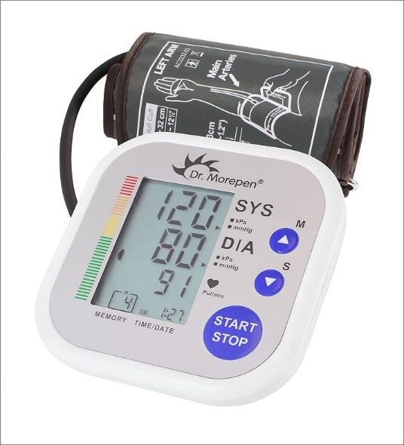
Specification of Dr. Morepen Bp02 Automatic Blood Pressure Monitor (White)
Dr. Morepen bp 02 is a fully automatic, digital blood pressure monitor
Quality b p monitor from dr. Morepen
Light weight product
Minimum Pressure Measurement Range: 40 mmHg Maximum Pressure Measurement Range: 230 mmHg Minimum Pulse Measurement Range: 40 beats/min Maximum Pulse Measurement Range: 199 beats/min Pulse Measurement Accuracy: (+/-) 5% Pressure Measurement Accuracy: (+/-) 3 mmHg
4 AAA Batteries

Slide 19
Specification of Instant Digital Simple Glucometer Kit
Accurate Results in Just 8 Seconds and its require minimum Blood Sample (0.5μL)
Latest GDH-FAD 4th Generation enzyme strip with ISO Compliant 15197:2013
Large Screen Display and 1000 Test memory with date & time.
Strip Ejection function, Strip indication light and Ketone warning Function
Before /After meal preset able feature helps you to monitor your blood sugar level
AccuSure Simple Glucometer Set includes : Meter with battery , 25 Strips , 10 Lancets , 1 Lancing device & Carrying Pouch with User manual.
Life time warranty support provided by AccuSure Simple Glucometer Set.

Slide 20
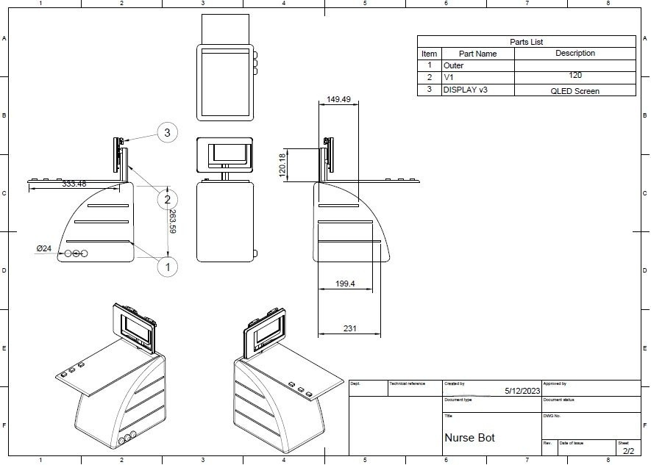
DESIGN

Slide 21
ALGORITHM
1. Start by including the necessary libraries and defining constants for Blynk, WIFI, LCD, and Pulse Oximeter.
2. Declare global variables and objects for the robot's movement, sensor readings, authentication, and network credentials.
3. Implement Blynk write functions for controlling the robot's movement (forward, backward, left, right).
4. Implement a Blynk write function for reading the blood pressure.
5. Set up the required pins, initialize the LCD, display startup messages, and establish a connection to the Wi-Fi network and Blynk server.6.
6. Initialize the pulse oximeter and set the IR LED current.

Slide 22
ALGORITHM
7. Enter the main loop:
a. Run Blynk to process any incoming commands or data.
b. Update the pulse oximeter.
c. Control the robot's movement based on the received commands.
d. Check if it's time to report sensor readings (based on a reporting period).
e. Retrieve the heart rate, SpO2, temperature, and glucose level from the sensors.
f. Display the sensor readings on the LCD.
g. Send the sensor data to the corresponding Blynk virtual pins.
8. Implement a helper function for a delay that also updates the pulse oximeter.

Slide 23
PROGRAM TO INTERFACE
//-ROBOT-
Blynk.run();
pox.update();
//Blynk.syncAll();
pox.update();
//Blynk.syncVirtual(V0, V1, V2, V3);
pox.update();
if (forward_f == true) {
pox.update();
digitalWrite(in1, HIGH);
pox.update();
digitalWrite(in2, LOW);
pox.update();
digitalWrite(in3, HIGH);
pox.update();
digitalWrite(in4, LOW);
pox.update();
}
else if (backward_f == true) {
pox.update();
digitalWrite(in1, LOW);
pox.update();
digitalWrite(in2, HIGH);
pox.update();
digitalWrite(in3, LOW);
pox.update();
digitalWrite(in4, HIGH);
pox.update();
}
else if (right_f == true) {
pox.update();
digitalWrite(in1, HIGH);
pox.update();
digitalWrite(in2, LOW);
pox.update();
digitalWrite(in3, LOW);
pox.update();
digitalWrite(in4, HIGH);
pox.update();
}
else if (left_f == true) {
pox.update();
digitalWrite(in1, LOW);
pox.update();
digitalWrite(in2, HIGH);
pox.update();
digitalWrite(in3, HIGH);
pox.update();
digitalWrite(in4, LOW);
pox.update();
}
else {
pox.update();
digitalWrite(in1, LOW);
pox.update();
digitalWrite(in2, LOW);
pox.update();
digitalWrite(in3, LOW);
pox.update();
digitalWrite(in4, LOW);
pox.update();
}

Slide 24
//-SENSORS-
pox.update();
if (millis() - tsLastReport > REPORTING_PERIOD_MS) {
pox.update();
bpm = pox.getHeartRate();
pox.update();
spo2 = pox.getSpO2();
pox.update();
if(analogRead(35)<=1 && gread_f == false){
pox.update();
glucose = random(90,110);
pox.update();
gread_f = true;
pox.update();
}
pox.update();
if(analogRead(35)>10){
pox.update();
gread_f = false;
pox.update();
}
pox.update();
tem = analogRead(34);
pox.update();
tem = (tem * 0.8050) / 10;
pox.update();
tem += 10;
pox.update();
lcd.clear();
pox.update();
lcd.setCursor(0, 0);
pox.update();
lcd.print("T:");
pox.update();
lcd.print(tem);
pox.update();
lcd.setCursor(8, 0);
pox.update();
lcd.print("HB:");
pox.update();
lcd.print((int)bpm);
pox.update();
lcd.setCursor(0, 1);
pox.update();
lcd.print("SPO2:");
pox.update();
lcd.print(spo2);
pox.update();
lcd.setCursor(8, 1);
pox.update();
lcd.print("G:");
pox.update();
lcd.print(glucose);
pox.update();
Blynk.virtualWrite(V4,tem);
pox.update();
Blynk.virtualWrite(V5,bpm);
pox.update();
Blynk.virtualWrite(V6,spo2);
pox.update();
Blynk.virtualWrite(V8,glucose);
pox.update();
tsLastReport = millis();
}
}

Slide 25
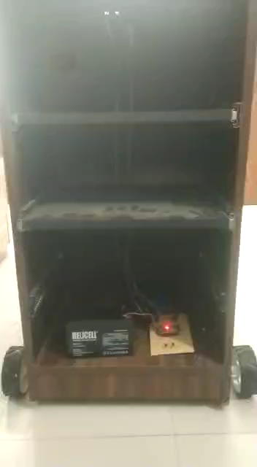
TESTING

Slide 26
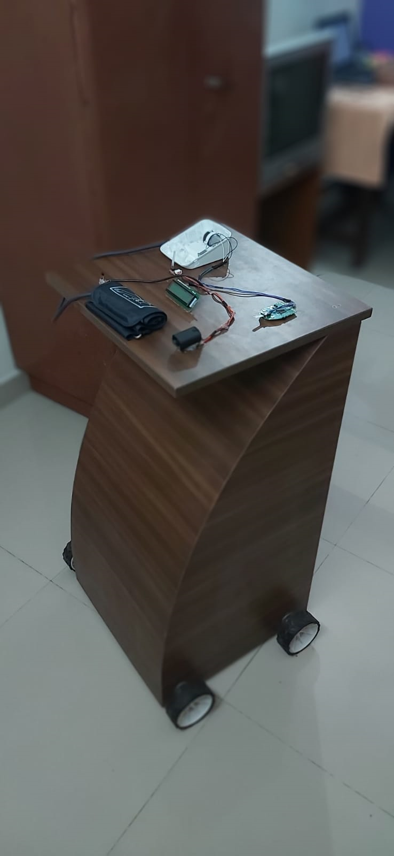
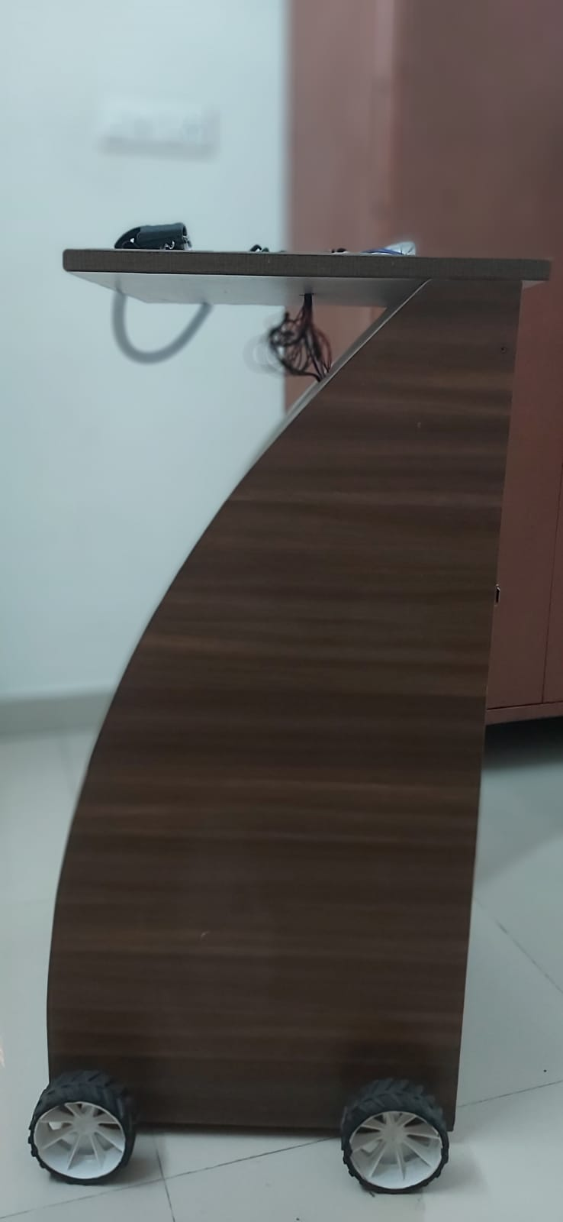
RESULTS
FRONT VIEW
SIDE VIEW

Slide 27
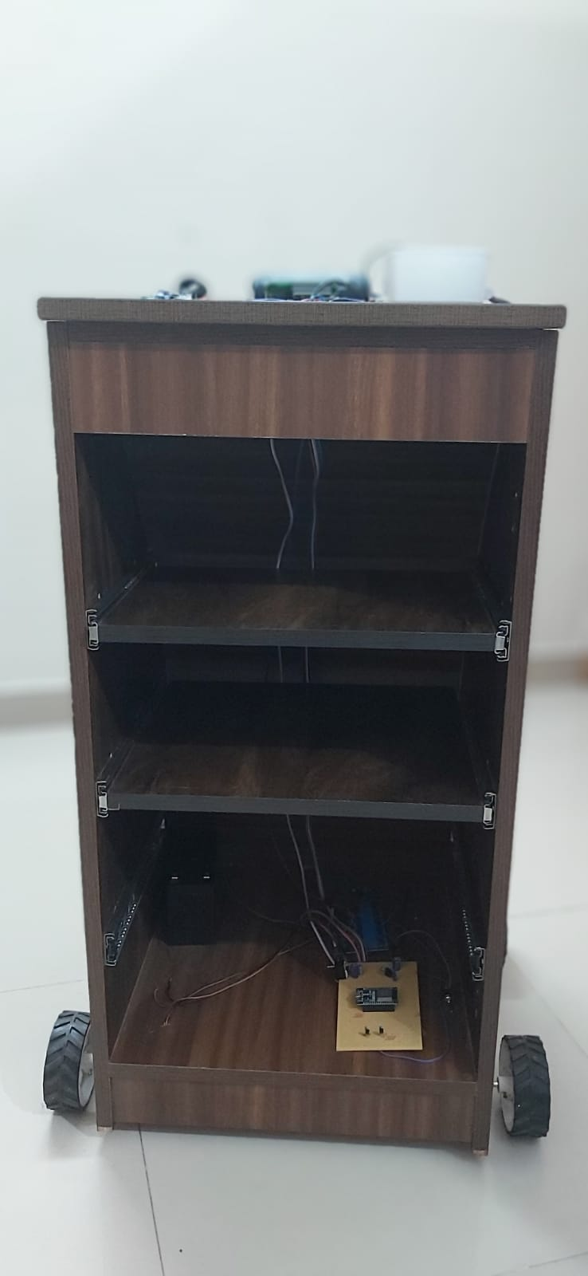
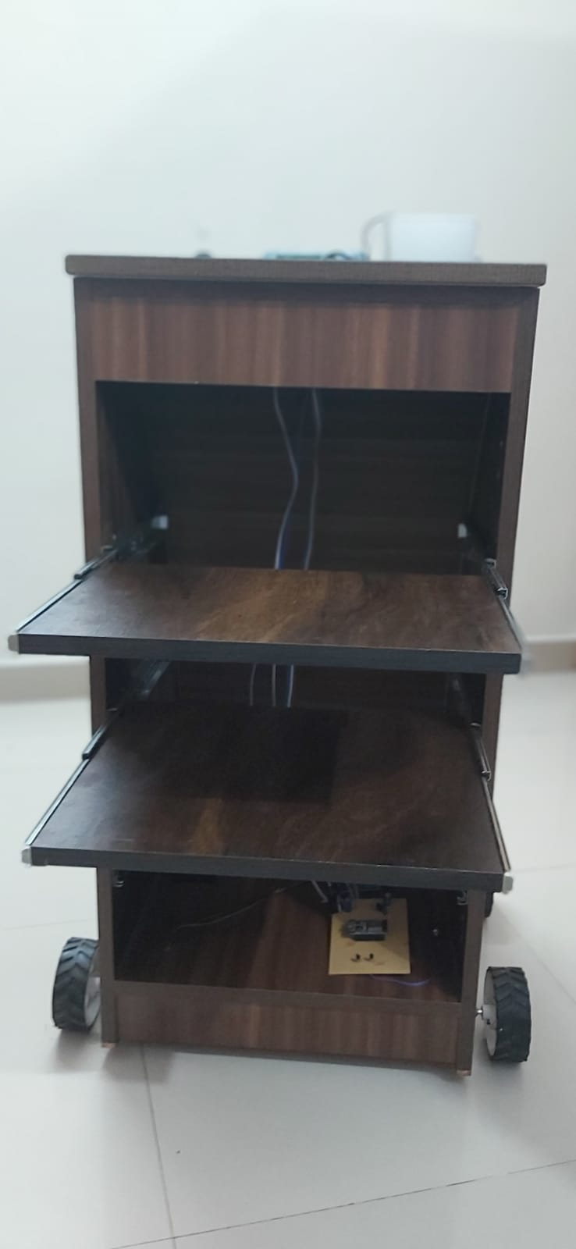
REAR VIEW (CLOSED)
REAR VIEW (OPENED)

Slide 28
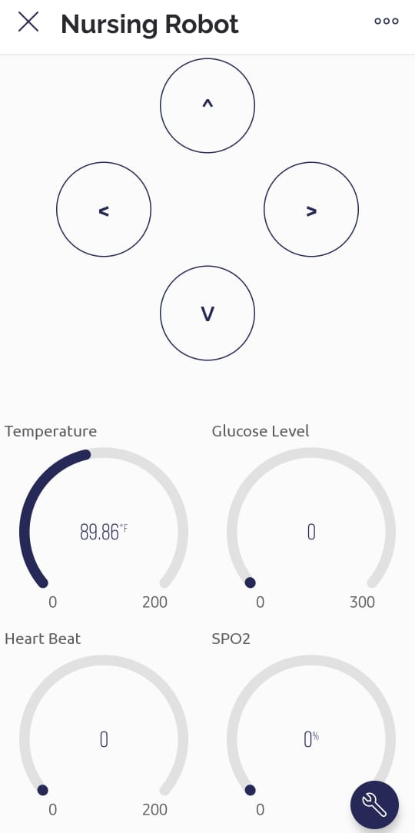
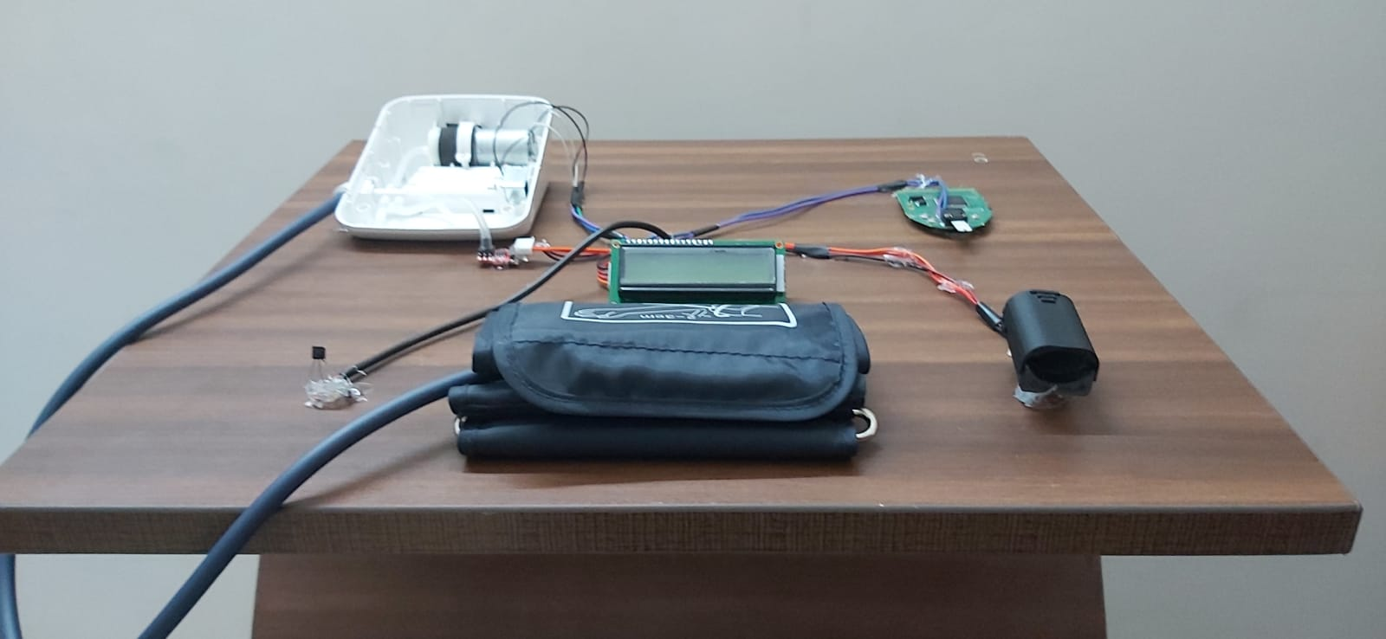
CONTROL PANEL
TOP VIEW

Slide 29
REFERENCES
[1] Abutaleb, Amal & Alsabhani, Jory & Alkinani, Sadeem & Alkaydi, Shahad & Alghamdi, Sara & Bensenouci, Ahmed. (2020). Design and Implementation of a Nurse Robot.
[2] Tanioka, T. , Osaka, K. , Locsin, R. , Yasuhara, Y. and Ito, H. (2017) Recommended Design and Direction of Development for Humanoid Nursing Robots Perspective from Nursing Researchers. Intelligent Control and Automation, 8, 96-110.
[3] Nieto Agraz C, Pfingsthorn M, Gliesche P, Eichelberg M and Hein A (2022) A Survey of Robotic Systems for Nursing Care. Front. Robot. AI 9:832248.
[4] Christoforou EG, Avgousti S, Ramdani N, Novales C and Panayides AS (2020) The Upcoming Role for Nursing and Assistive Robotics: Opportunities and Challenges Ahead. Front. Digit. Health 2:585656. doi: 10.3389/fdgth.2020.585656
[5] Servaty R, Kersten A, Brukamp K, et al. Implementation of robotic devices in nursing care. Barriers and facilitators: an integrative review. BMJ Open 2020;10:e038650. doi:10.1136/ bmjopen-2020-038650
[6] Servaty, Ricarda, et al. "Implementation of robotic devices in nursing care. Barriers and facilitators: an integrative review." BMJ open 10.9 (2020): e038650.

Slide 30
Thank you……

